Slide 1
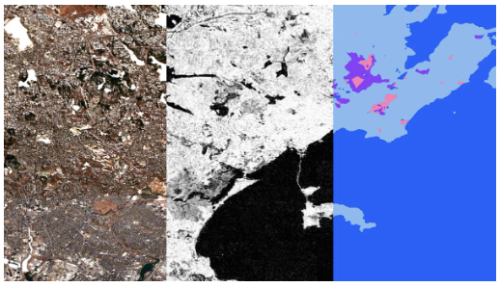
Fine-tuning of the Prithvi Foundational Model
12th May 2025 | Abdus Salam ictp

Slide 2
What is a foundational model?
AI models typically decompose inputs (e.g., 2-D images or 3-D videos) into a “latent space” from which to derive “semantic relationships” for downstream user-defined tasks
Ideally, AI models could generalise representations to cater to any user-defined tasks, but this requires training on vast amounts of data so usually task-specific models are trained
Foundational models provide a new paradigm of models trained and maintained on vast amounts of data from which downstream tasks can be tuned towards, i.e., building blocks

Slide 3
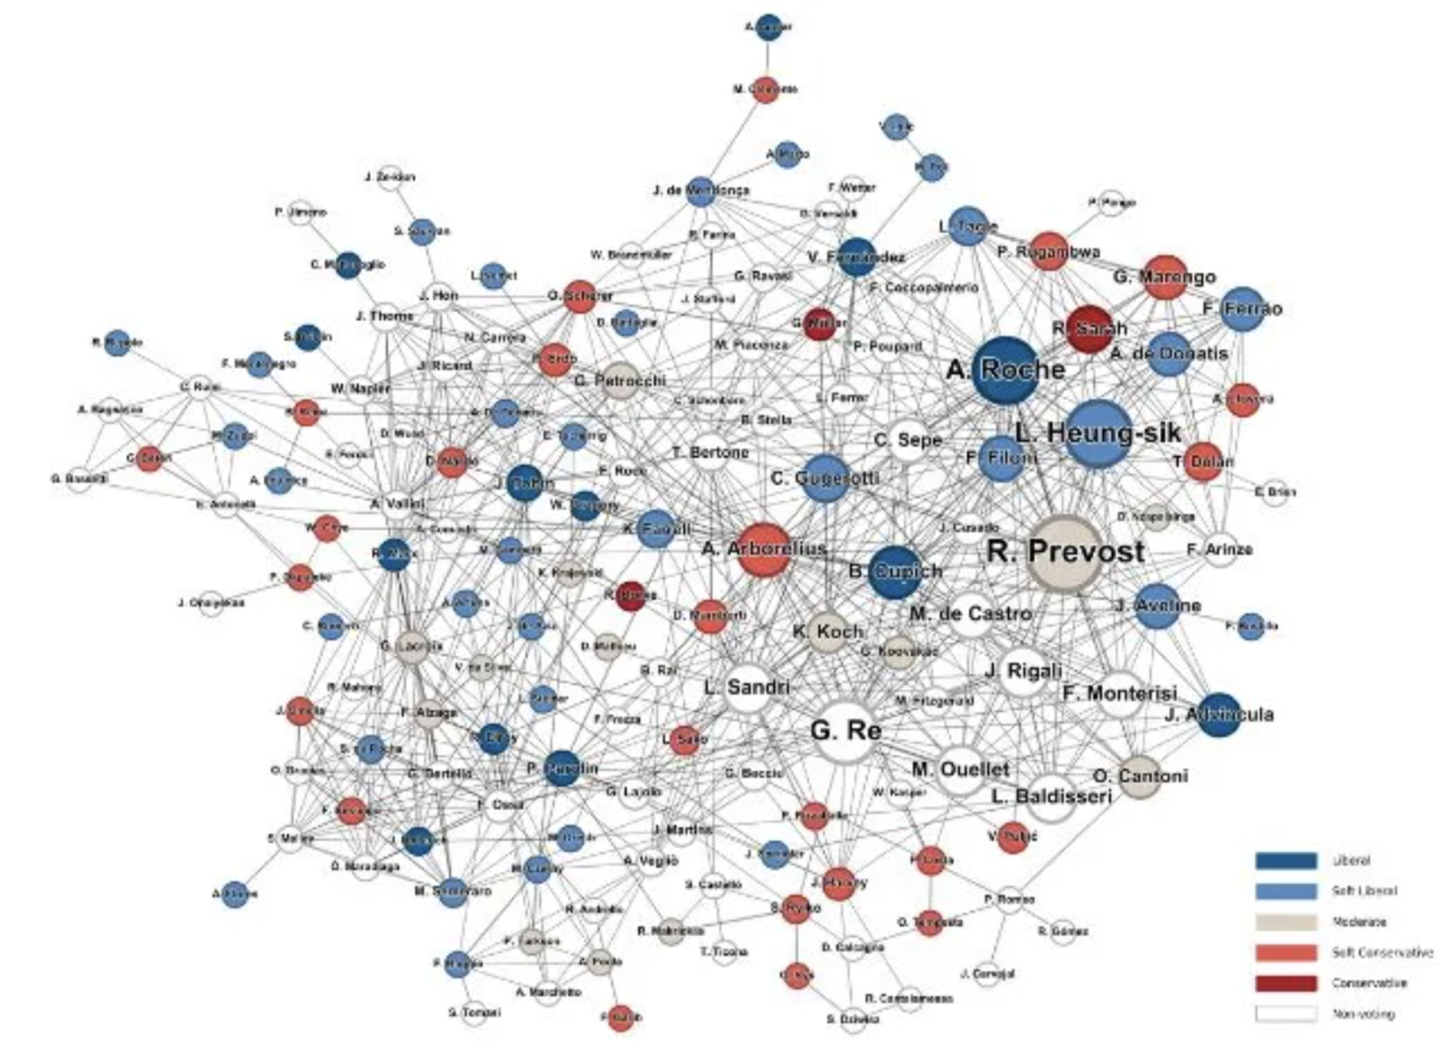
Latent representation and semantic relationships? (oversimplified intuition)

Slide 4
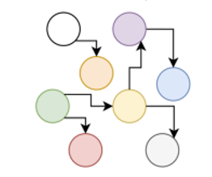
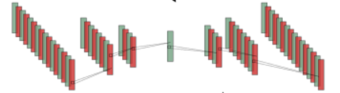
Foundational models in context of everything we have done till now
Expert Systems
Machine Learning
Deep Learning
Foundational Models
Knowledge base
Inference Engine
Manually created
Set rules and facts
Scalable to larger datasets
Feature engineering needed
Task-specific
More flexible
Learn at scale with self supervision
Still task-specific
Adaptable to downstream tasks

Slide 5
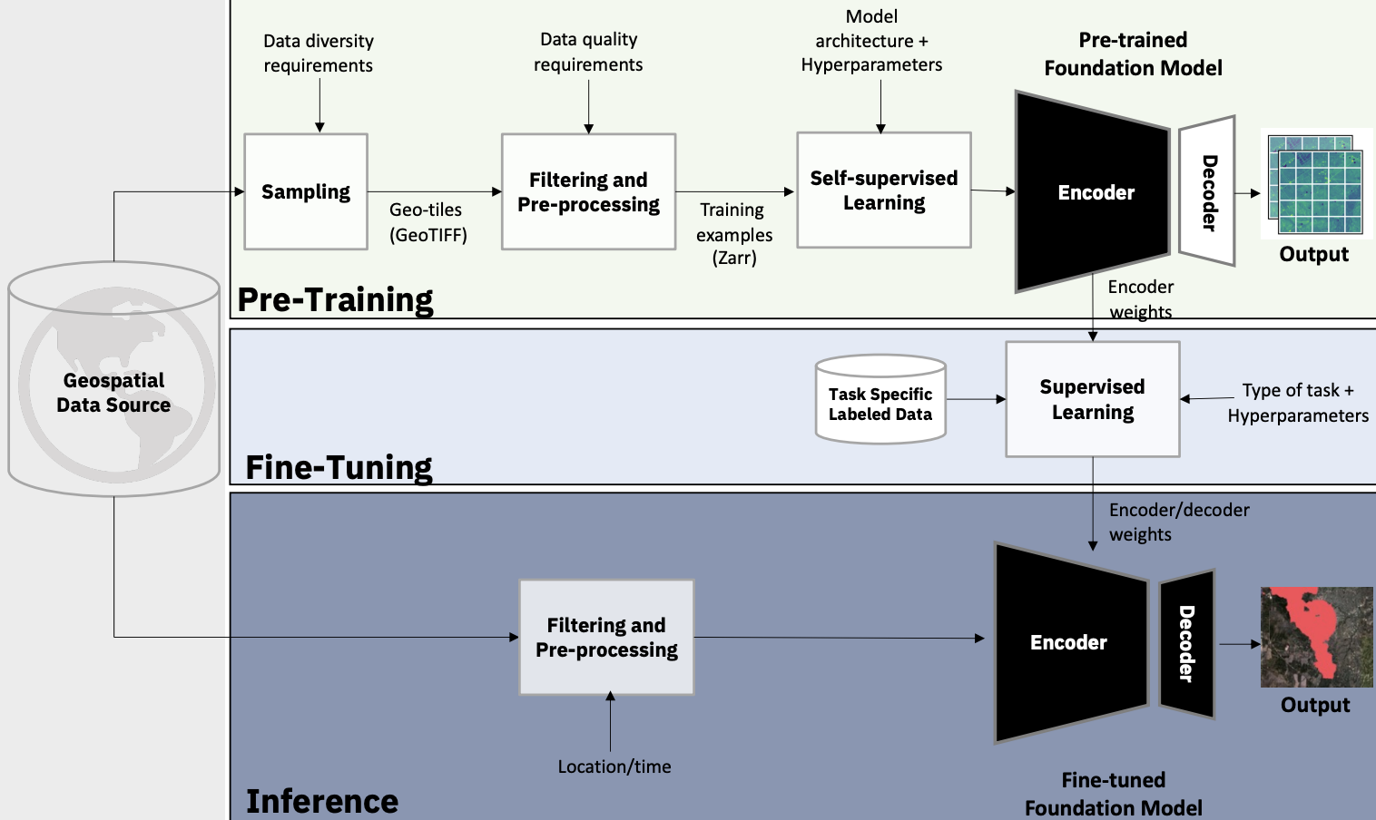


Framework for foundational models
https://arxiv.org/pdf/2310.18660. Last accessed: 11.05.2025

Slide 6
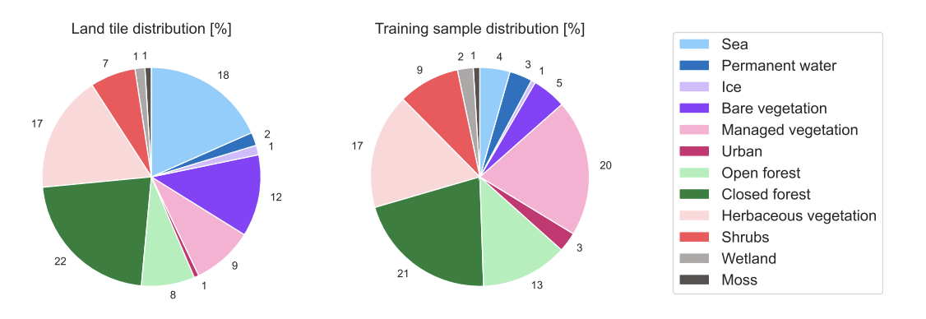
Data
Harmonised Landsat data:
Landsat-8 and Landsat-9
Sentinel2A and Sentinel 2B
Six common channels used: Blue, Green, Red, NIR, SWIR1, and SWIR2
Sampling done to represent land-use types and geographical regions

Slide 7
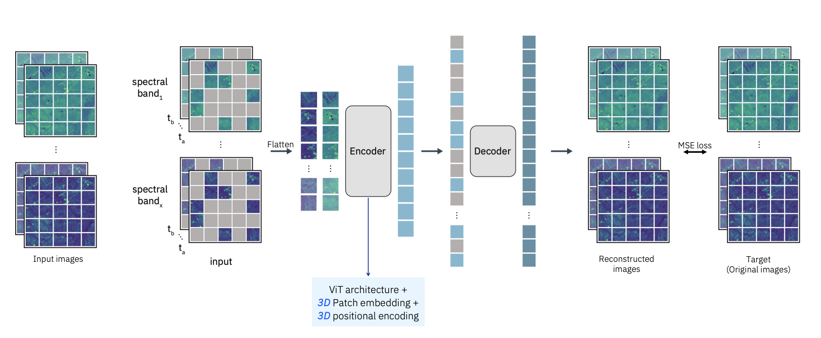
Prithvi architecture

Slide 8
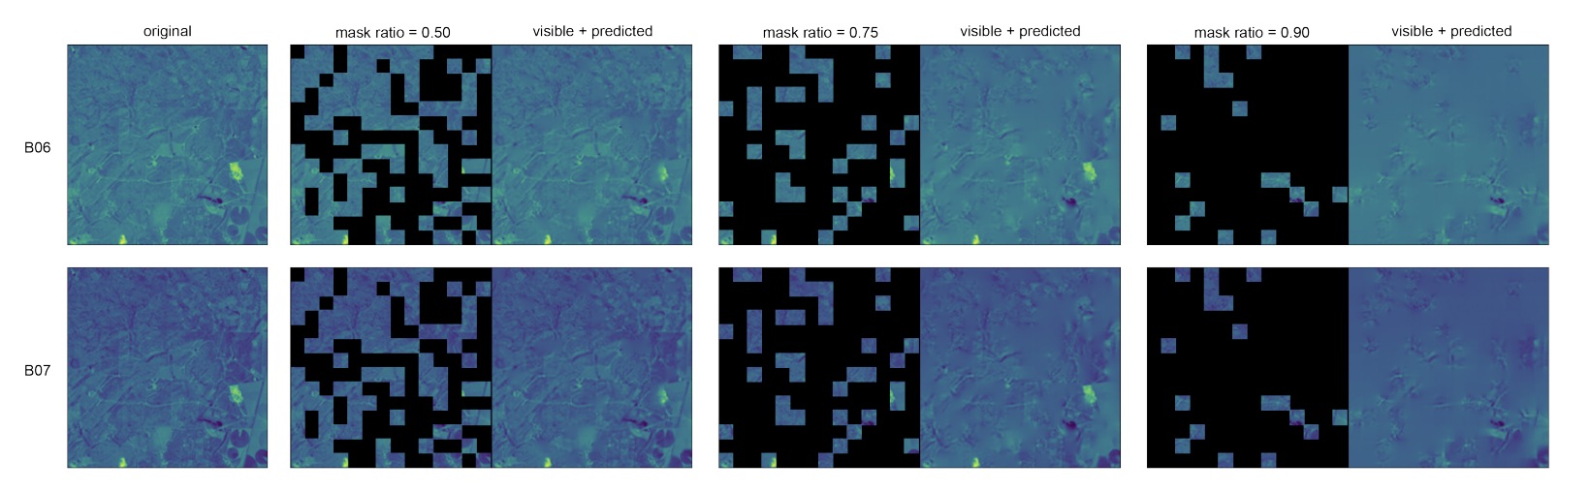
Example reconstruction

Slide 9
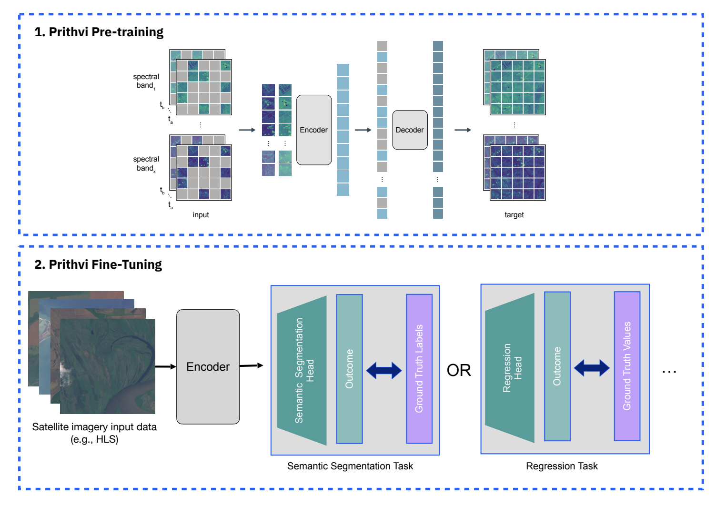
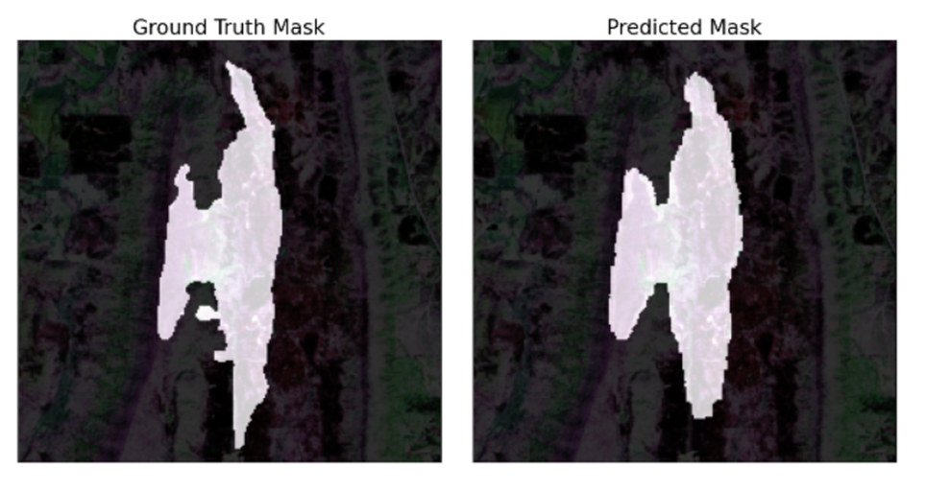
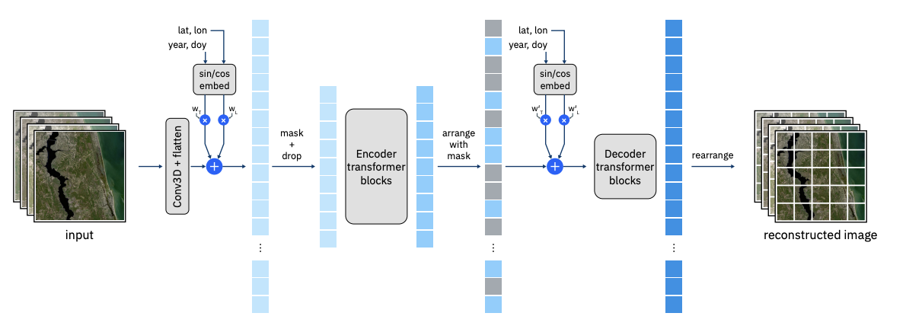
Our goal today
Demonstrate how to set up fine-tuning to burn-scar detection
Use Cloud-compute
See here: https://docs.google.com/document/d/1ExBT7lYuS-AvSfkQz8BK22l1h8n5a5Ucx9cAjDti2eY/edit?tab=t.0

Slide 10
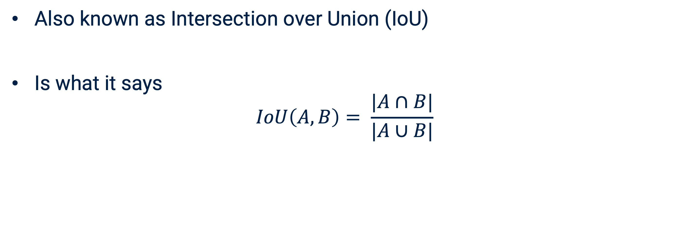
Good to know: Jaccard index
Also known as Intersection over Union (IoU)
Is what it says
$$IoU\left(A,B\right)= \frac{|A∩B|}{|A∪B|}$$

Slide 11
Prithvi fine-tuning: https://github.com/NASA-IMPACT/ESA-NASA-workshop-2025/

Slide 12
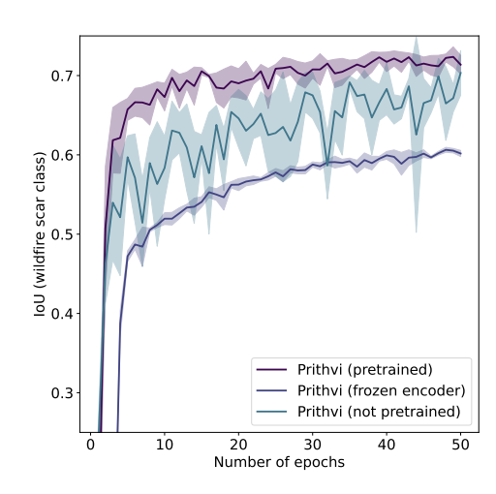
Some considerations: pre-train, freeze or neither?

Slide 13
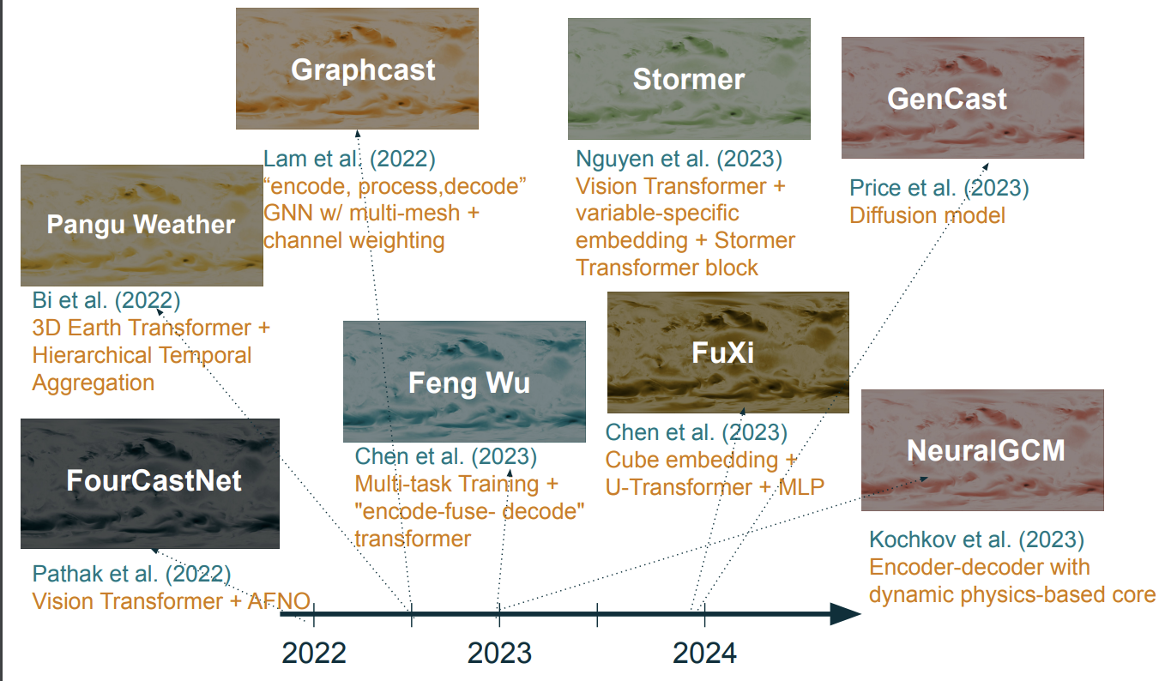
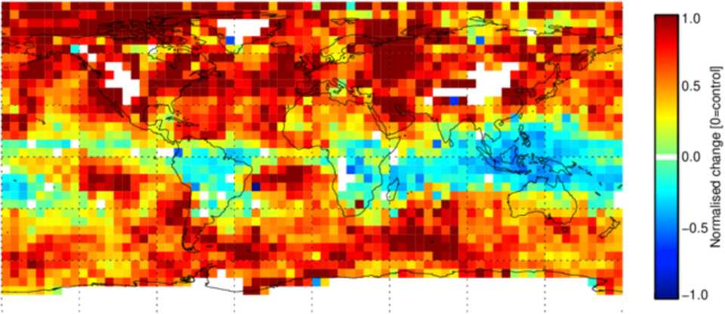
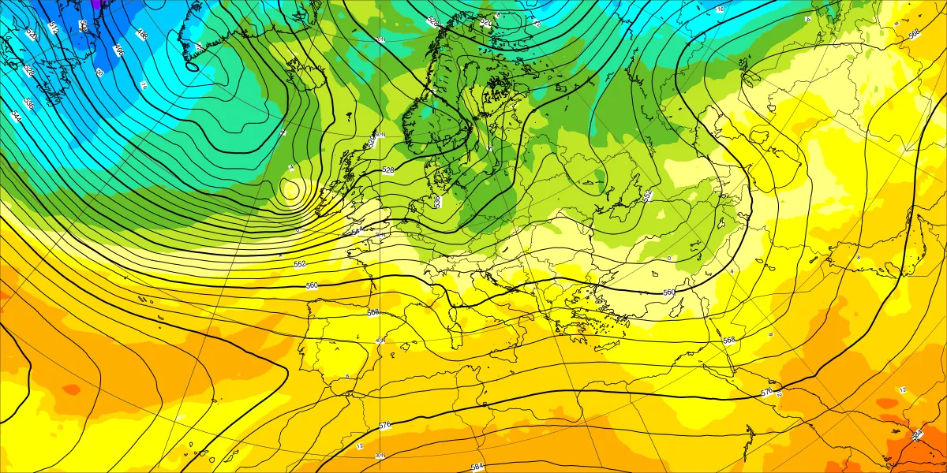
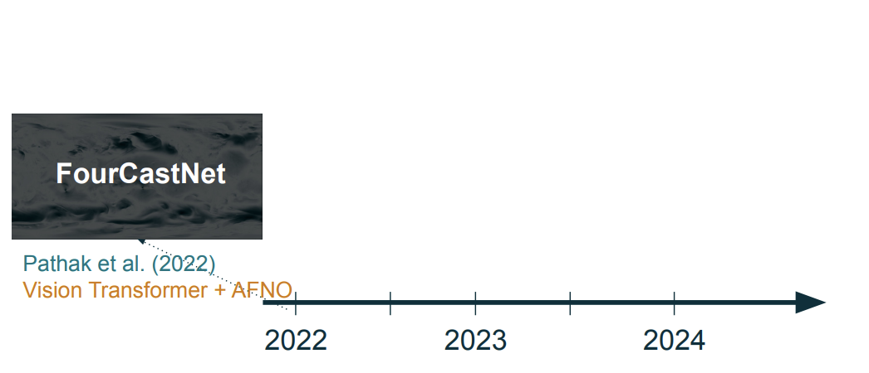
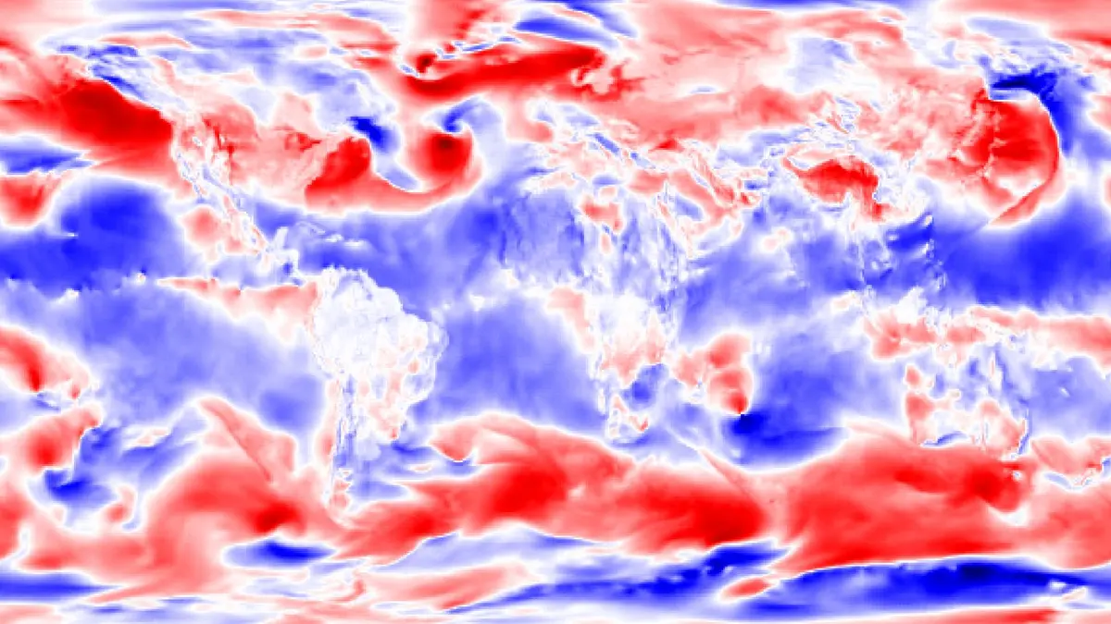
Alexe et al. (2024)
GNN with on-the-fly neighbourhood search
GraphDop
AIFS
Lang et al. (2024)
GNN with shifted window attention
Prithvi WxC
Schmude et al. (2024)
Masked Auto-Encoder
Notes:
PUT IN AIFS, GraphDOP, Aurora and Prithvi-WXC, add deterministic vs probabilistic

Slide 14
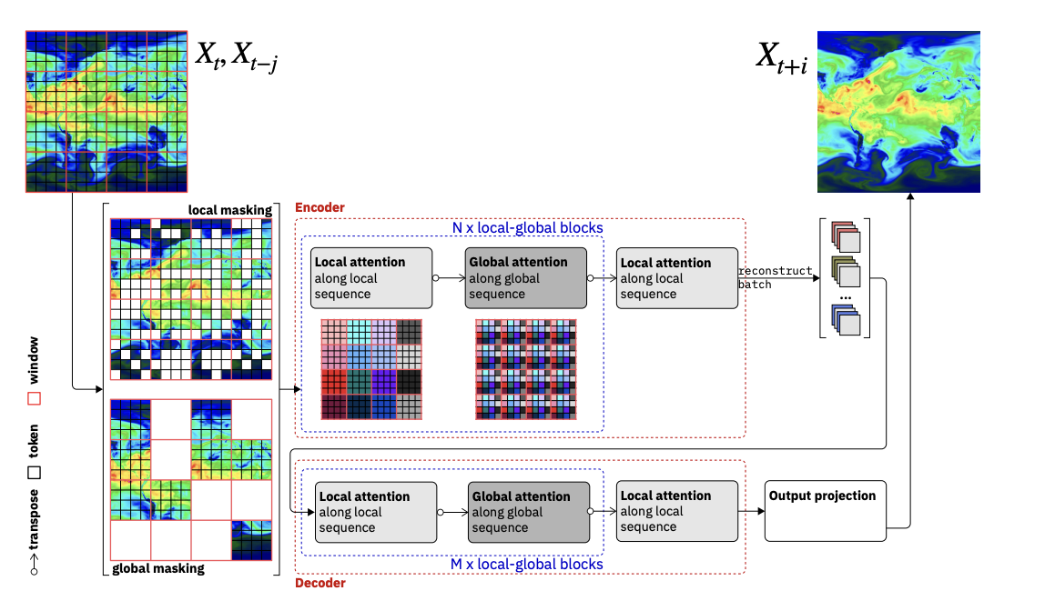
Prithvi WxC
https://arxiv.org/pdf/2409.13598. Last accessed: 11.05.2025

